Slide 1
Binomial Distribution Python

Slide 2
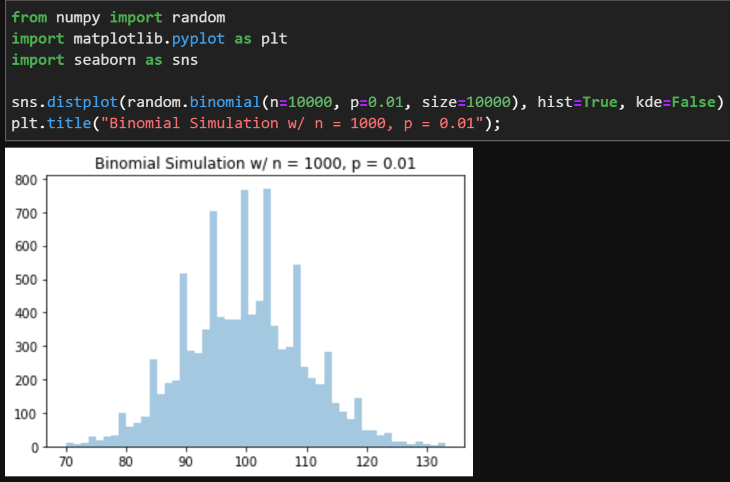

Slide 3

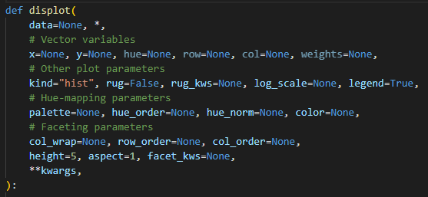

Slide 4
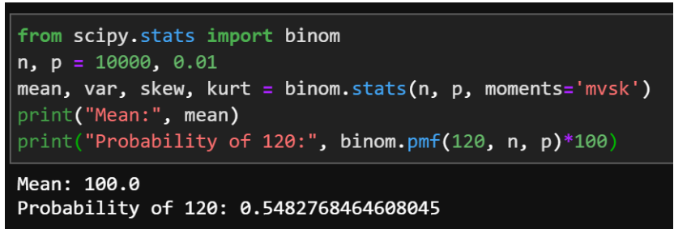

Slide 5


Slide 6

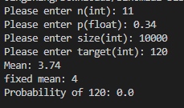


Slide 7



Slide 8
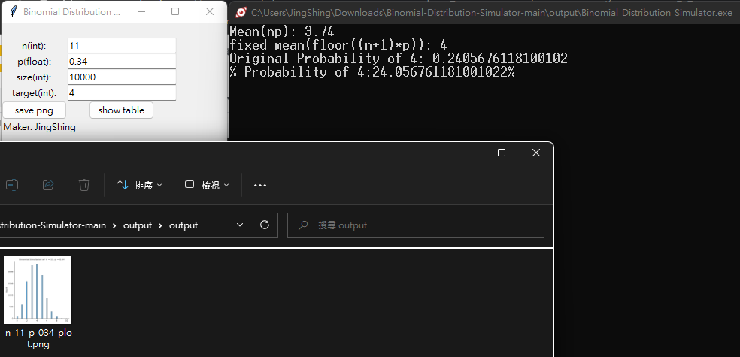

Slide 9
感謝聆聽，祝各位新年快樂

